Slide 1
Pleasure Positive Campaign
Top content

Slide 2
Facebook

Slide 3
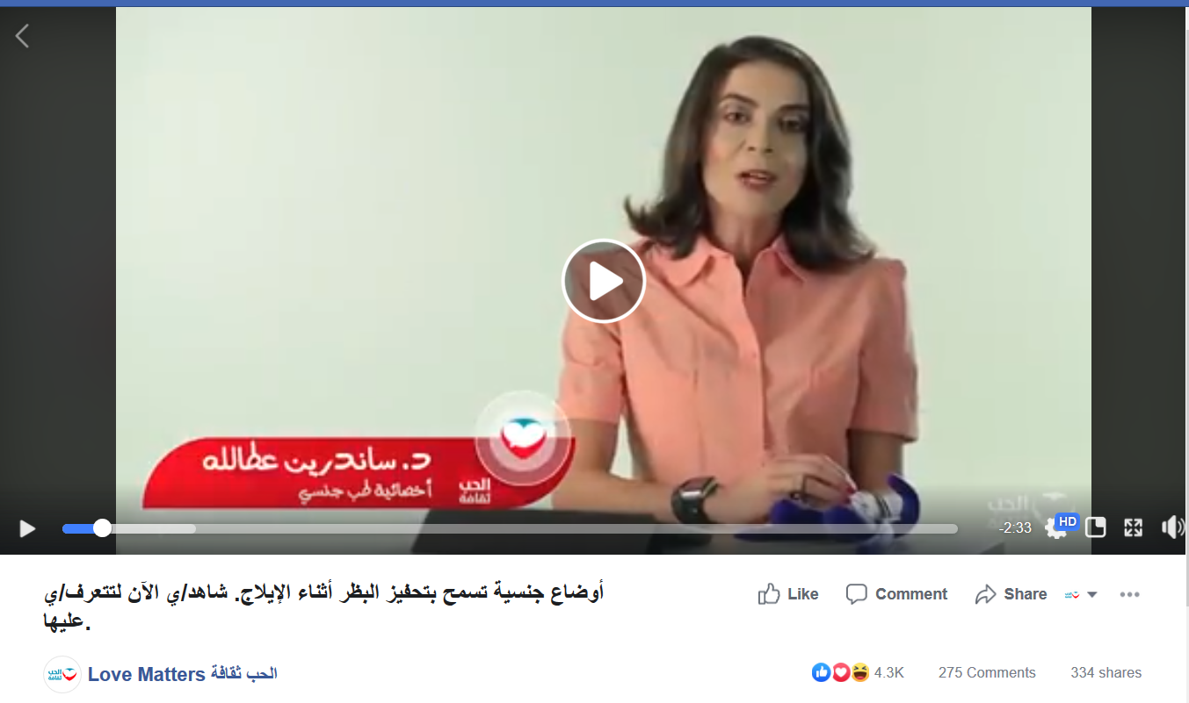
FB Top Post in Engagement
A video explaining sexual positions that couple can do to stimulate the clitoris during intercourse by one of the experts LMA partner with (Dr. Sanderine Attallah).

Slide 4
FB Top Post in Engagement
An animation video showing the different forms of pleasure. It is the main video of the campaign.

Slide 5
FB Top Post in Engagement
One of the posts we tailor for social media: Your Sexual Dictionary in Arabic.
This type of posts focuses on explaining the different terminologies related to sexual health and sexuality.
This post was explaining what sexual pleasure is.

Slide 6
FB Top Post in Negative feedback
A video explaining sexual positions that couple can do to stimulate the clitoris during intercourse by one of the experts LMA partner with (Dr. Sanderine Attallah).

Slide 7
FB Top Post in Negative feedback
One of the posts we tailor for social media: Kama Sutra in Arabic.
This type of posts focuses on explaining the different sexual positions, their pros and cons
This post was about 69 position.

Slide 8
FB Top Post in Negative feedback
One of the posts we tailor for social media: Kama Sutra in Arabic.
This type of posts focuses on explaining the different sexual positions, their pros and cons
This post was about the doggy position.

Slide 9
Twitter Top Tweets
One of the Tweets we tailor for social media: Kama Sutra in Arabic.
This type of tweets focuses on explaining the different sexual positions, their pros and cons
This tweet was about the doggy position.

Slide 10
Twitter Top Tweets
A video explaining oral sex by one of the experts LMA partner with (Dr. Sanderine Attallah).

Slide 11
Twitter Top Tweets
A video explaining sexual positions that couple can do to stimulate the clitoris during intercourse by one of the experts LMA partner with (Dr. Sanderine Attallah).

Slide 12
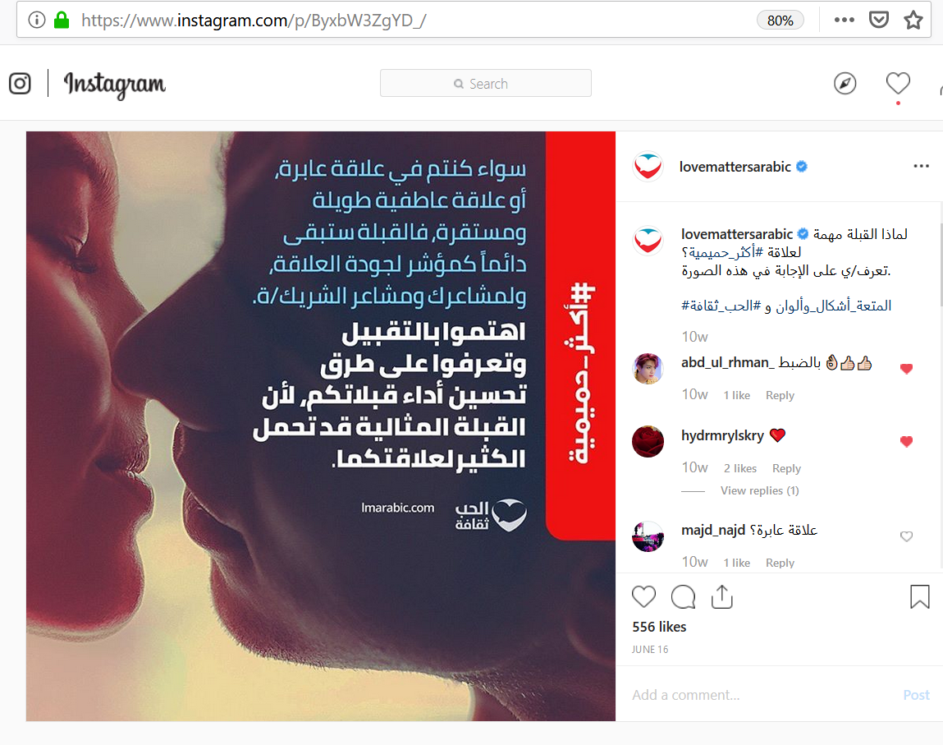
Instagram top liked posts
A post explaining why kissing is important!

Slide 13
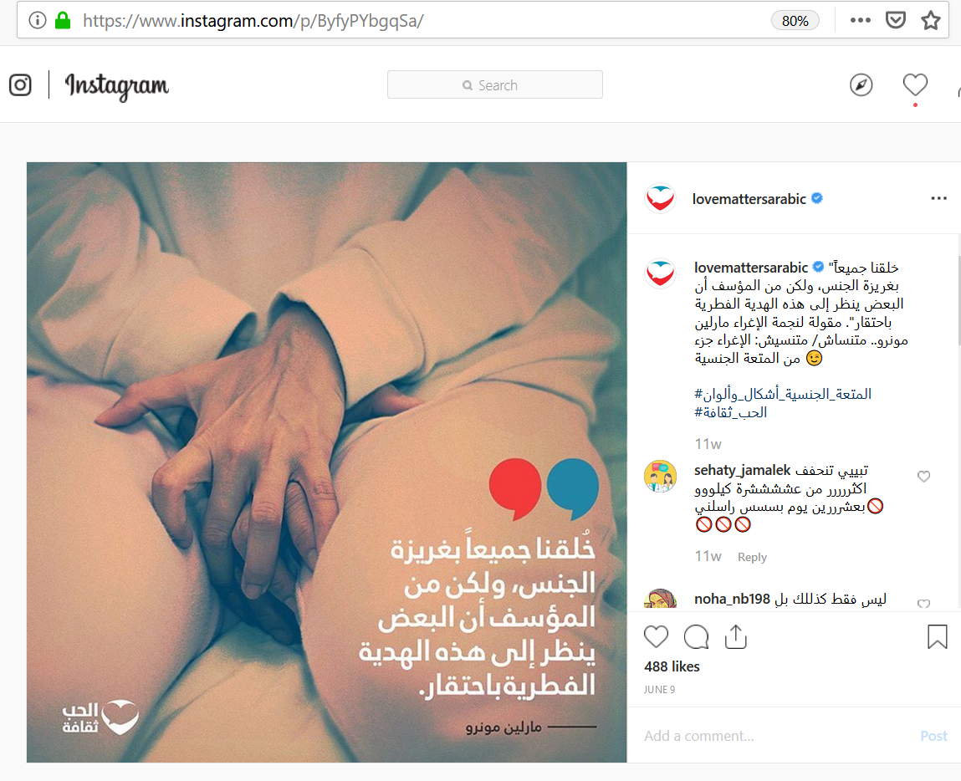
Instagram top liked posts
A quote for Marylin Monroe about sex shame.

Slide 14
Instagram top liked posts
Edge of heaven sex position.

Slide 15
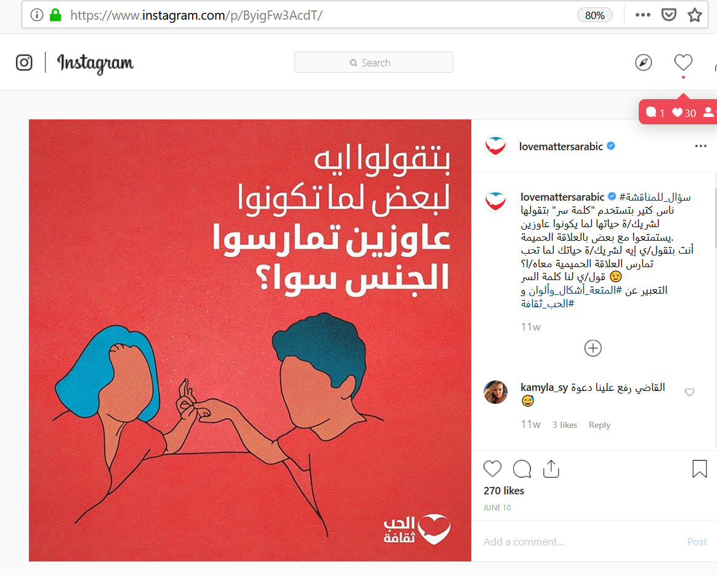
Instagram top posts in terms of comments
A Question: what do you usually say to your partner when you want to have sex?

Slide 16
Instagram top posts in terms of comments
Sexual Dictionary in Arabic (Oral sex)

Slide 17
Instagram top posts in terms of comments
Kama Sutra in Arabic: Doggy Style.

Slide 18
Thank You

